Slide 1
Women
Lead
Humanitarian
Response
Farah Kabir
Country Director
ActionAid Bangladesh

Slide 2
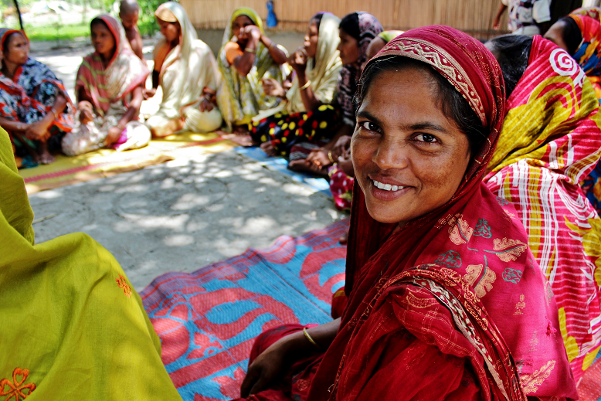
SDG goal 5
achieve gender equality and empower all women and girls
5.5 Women’s full and effective participation and equal opportunities for leadership at all levels of decision-making in political, economic and public life

Slide 3
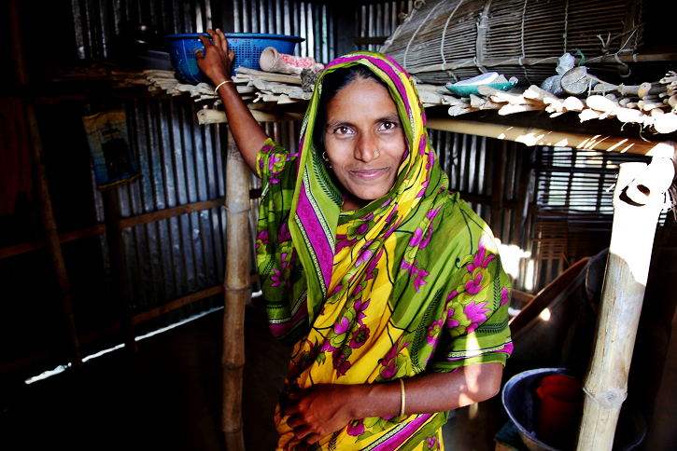
SFDRR priority 4
enhancing disaster preparedness for effective response and to ‘build back better’ in 3R
32. ...further strengthen disaster preparedness for response, take action in anticipation of events... ensure that capacities are in place...

Slide 4
OUTCOME

Slide 5
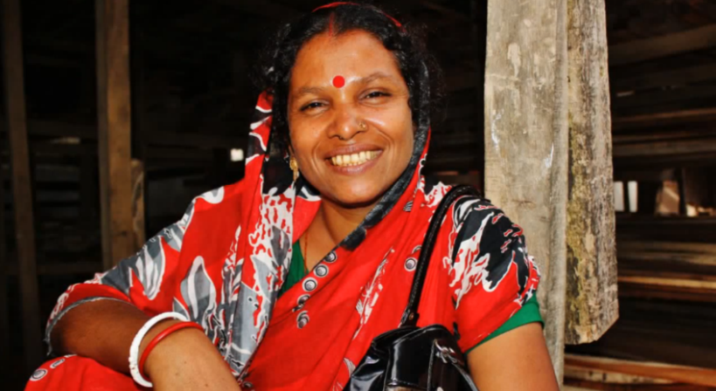
IMPACT

Slide 6
RESULTS
of long-term programme involving women
Equal-rights and decision-making
Though uneasy in the onset, the men of the communities, partner NGO and local government officials appreciated WLER project. Local govt. now engages these women in disaster management activities.
Recognition and ownership
These volunteers/women leaders shared their experiences in AMCDRR Bangkok 2014 and in WCDRR Sendai 2015. They demanded more investment on women’s agency building, and received Light House Achievement Award in 2013 from UNFCCC.

Slide 7
FUTURE
what more needs to be done to secure the achievements
Governments to create enabling policies
Making long-term investment on women
Scaling up women-focused initiatives
Spreading the story of women leadership

Slide 8
TALK BACK
farah.kabir
@actionaid.org
THANK
YOU!
ActionAid Bangladesh
House 8, Road 136,
Gulshan 1, Dhaka 1212
Bangladesh
actionaid.org/bangladesh

